Slide 1
Entrepreneurs of
Western North Carolina’s
Tourism Industry
Jeanette E. Marceau
Masters of Entrepreneurs
Western Carolina University
Cohort 8
December 2010

Slide 2
Hello I am Jeanette Marceau of Nantahala Cabins from Western North Carolina. I am doing an in depth series on the entrepreneurs of Western North Carolina’s tourism industry for the Masters of Entrepreneurship Program at Western Carolina University. This will be an eight part series beginning with an interview with Sara Smith who majored in Graphic Design at Western Carolina University. The other parts of the series will include entrepreneurs of the tourism industry in Western North Carolina particularly the Nantahala River and Fontana Lake regions of Bryson City, North Carolina.

Slide 3
Western North Carolina is a premier outdoor vacation capital. “National Geographic Adventure and ABC's Good Morning America's "Vacationland" series named the Nantahala River the number one place to spend a wet and wild vacation in the US. The book "101 Best Outdoor Towns" named Bryson City the nation's third best whitewater paddling town.” Not only is rating popular but the area also has horseback riding, biking, zip lining, boating on Fontana Lake, jeep tours, hiking and many more outdoor attractions for families. Being a tourist area there are also many accommodations and restaurants to choose from. The down turn in the economy has hit this area hard and the entrepreneurs are struggling to survive and they are creating innovative ways to succeed.

Slide 4
Cohort Interview Questions for
Sara Smith
Western Carolina University
Master of Entrepreneurship
ENT 600 - Entrepreneurial Planning – Fall 2010
Cohort Interview Questions
Interview of Sara Smith by Jeanette E. Marceau
Sara Smith
High School Diploma – May 2004
Bachelor of Fine Arts – Graphic Design – May 2008
Master of Entrepreneurship – pursuing
Work Experience – customer service, graphic design, and IT support
What do you feel is the major difference between entrepreneurs and those who work for someone else?
What ignited the spark in you to enter WCU’s Master of Entrepreneurship program to help you start a new business venture?
What to you seek to gain from the Master of Entrepreneurship Program?
What field do you feel would benefit from your entrepreneur spirit?
What do you see as innovation in that field in the future that you could capitalize on and create a successful entrepreneurial endeavor?
What would you say are the five key elements for starting and running a successful business?
What is your greatest fear, and how do you manage fear?
How will you manage your family life and business life? (Will they intermingle?)
Would your husband be involved in your entrepreneurial enterprise and in what capacity?
What are your hobbies? What do you do in your non-work time? How can your hobbies or activities from your non work time help you as an entrepreneur?
What makes you happy?
Where you see yourself and your newly created business in 10 years? 20 years?

Slide 5
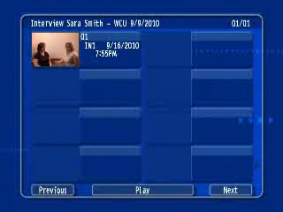
Cohort Interview with Sara Smith
Please wait for interview to begin.

Slide 6
Entrepreneurial Interview Questions
Tell me a little bit about how you started ______________ (use the name of the company),
sort of an overview, please…
What ignited the spark in you to start your business venture or to make significant changes in an existing business? How did the idea for your business come about?
What would you say are the top three skills needed to be a successful entrepreneur?
Do you believe there is some sort of pattern or formula to becoming a successful entrepreneur?
What would you say are the five key elements for starting and running a successful business?
What is your greatest fear, and how do you manage fear?
What do you feel is the major difference between entrepreneurs and those who work for someone else?
How big is tourism for your business? What percentage is local and what percentage is tourism?
How has the current economy changed your business?
When do you see the economy improving and your business improving?
What do you see as the future for yourself and your business in 1 year, 5 years, 10 years, and 20 years?
How do you go about marketing your business?
What has been your most successful form of marketing?
How has the current economy changed your marketing strategies?
What has been your most satisfying moment in business?
How do you define success?
What is the best way to achieve long-term success?
Do you consider your business successful?
How are things going in your company in general, right now: are you hiring, downsizing, or "staying as you are" in terms of your company's workforce; are sales up, down, or flat?
How do you keep up with best practices in your industry?
What three pieces of advice would you give to college students who want to become entrepreneurs?

Slide 7

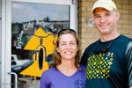
Interview with Andy Zivinsky
Bryson City Bicycles
Bryson City Bicycles
Open 10 to 6 Monday through Saturday, 11 to 4 on Sunday, and closed Wednesday.
157 Everett St.
Bryson City, NC 28713
spokeyjoe@brysoncitybicycles.com
P 828 488 1988
http://www.brysoncitybicycles.com/

Slide 8
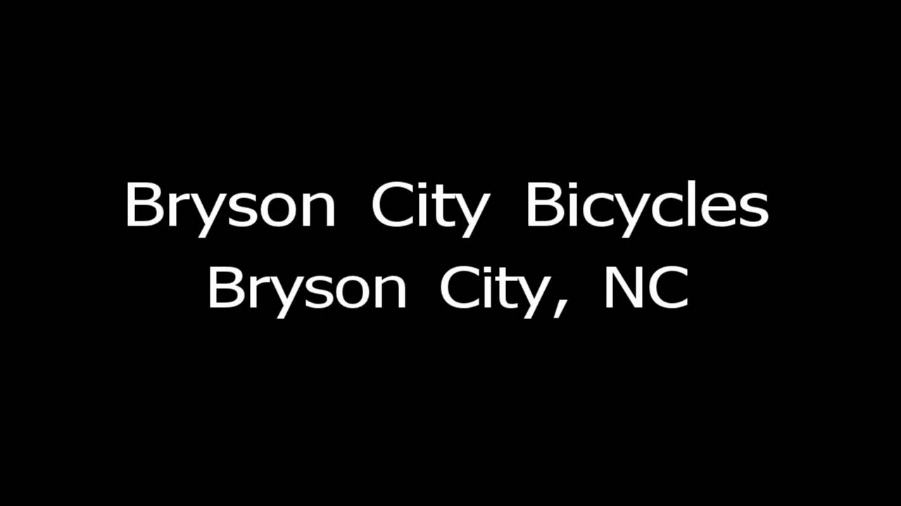
Bryson City Bicycle
Please wait for interview to begin.

Slide 9

Interview with David Loftis of Nantahala Village Riding Stable
Nantahala Village Riding Stable
Call or write to:
828-488-9649 (office)
828-488-8600 (reservations during closed season and after hours.)
177 Jenkins rd, Bryson city, NC, 28713
email us at nantahalastable@live.com
      DATES OPEN:
      Easter weekend - Memorial Day
      10.00am - 4.00pm (Friday - Sunday)
      Memorial Day - Labor Day
      9.00am - 4.00 pm ( Monday - Thursday)
      9.00am - 5.00pm (Friday - Saturday)
      9.00am - 3.00pm (Sunday - Saturday)
      Labor day - Thanksgiving weekend
      10.00am - 4.00pm (Friday - Sunday)
RATES:
1 hr- $20
2 hr- $40
3 hr- $60
1/2 day*- $80
all day*- $160
* requires 2 or more riders and a 3 day notice. All day trips are trailer driven to Tsali rec. area.
over night trips available, call for details. 250 pound weight limit. Group rides available with maximum of 18 riders.
Children of all ages my ride. Children under the age of 4 may ride with an adult for half price, adult and child may not exceed weight limit.

Slide 10
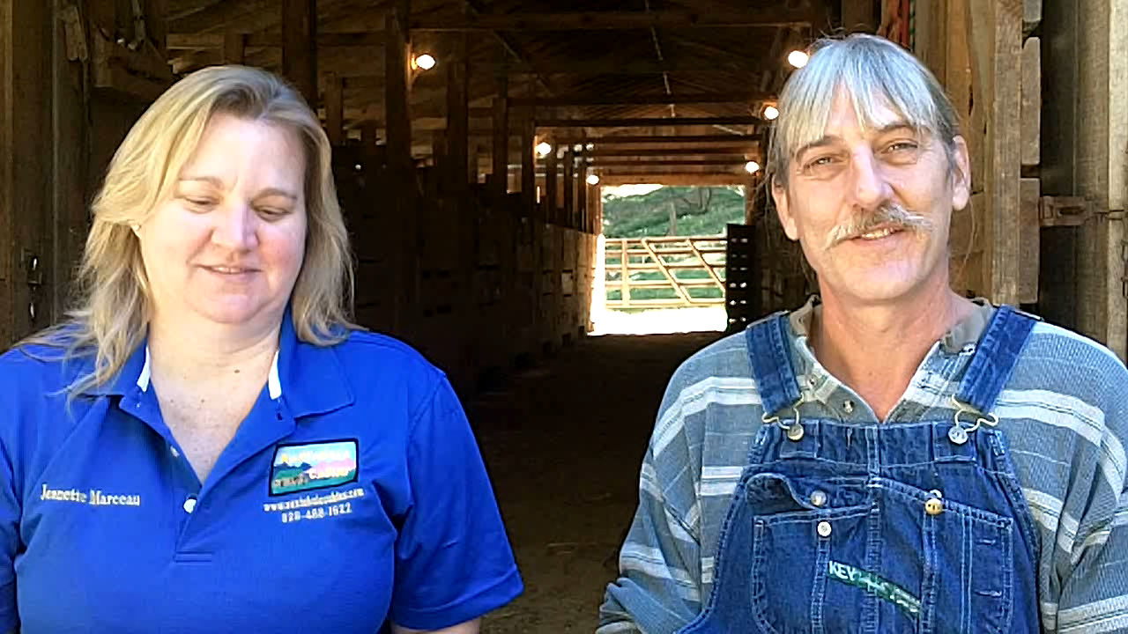
Nantahala Stables

Slide 11

Interview with Barry Tetrault of
The Filing Station Deli
Featured In The July 2010 issue Of Our State Magazine
Choice For Swain County NC ,Top 100 Eateries !
The Filling Station Deli and Sub Shop
145 Everett Street
Bryson City , NC 28713
ph: 828-488-1919
fax: 828-488-0603
barrytetrault@thefillingstationdeli.com
http://www.thefillingstationdeli.com/

Slide 12
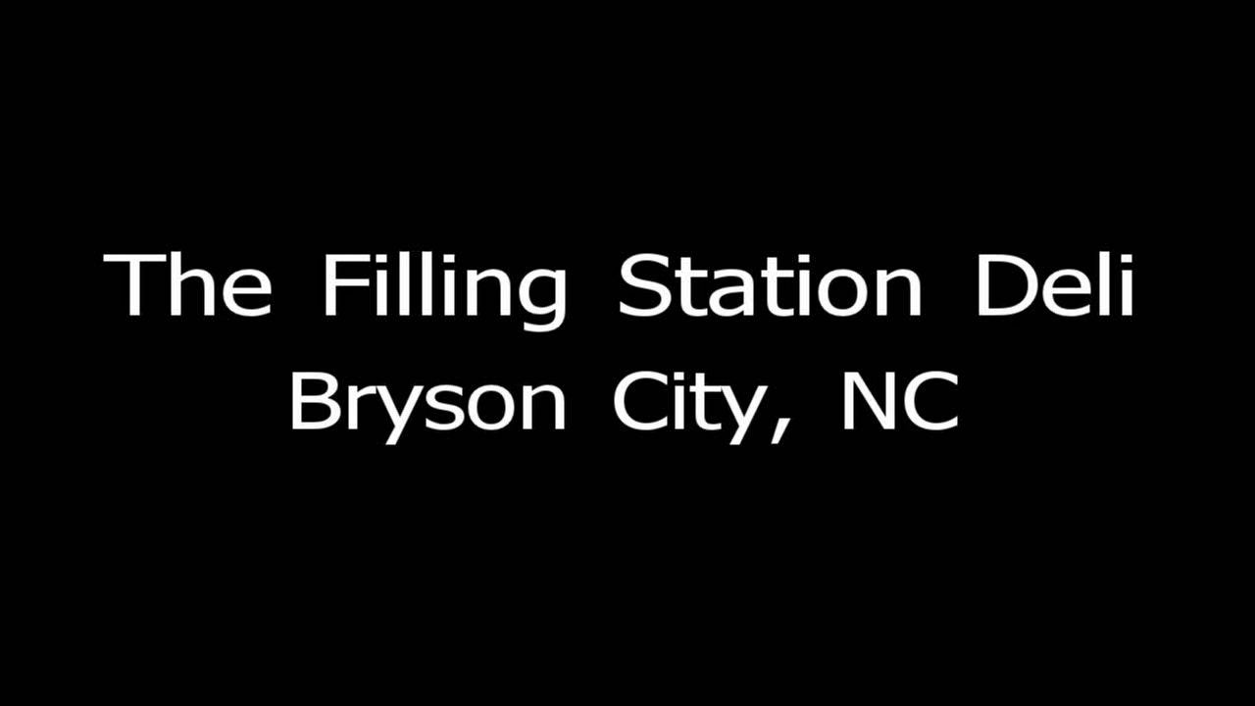
Filling Station Deli
Please wait for interview to begin.

Slide 13

Interview with Melissa Parton of Smoky Mountain Bait & Tackle

Slide 14
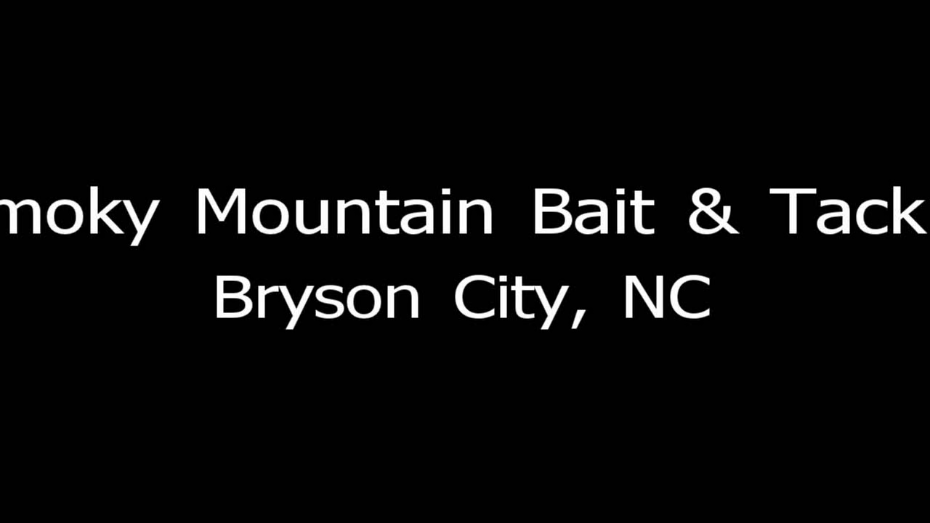
Smoky Mountain Bait & Tackle
Please wait for interview to begin.

Slide 15
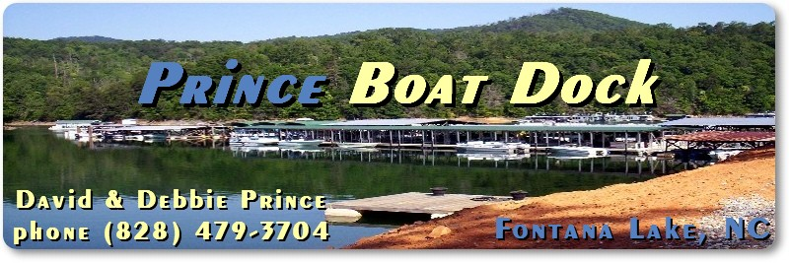
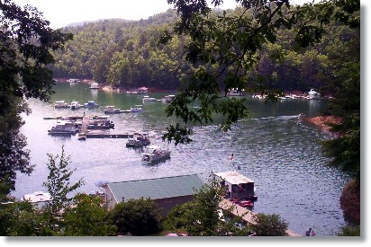
Interview with David Prince of
Prince Boat Dock
Prince Boat Dock
237 Prince Boat Dock Rd
Almond, NC 28702
(828) 479-3704

Slide 16
Prince Boat Dock

Slide 17


Interview with Jeanette Marceau of Nantahala Cabins

Slide 18
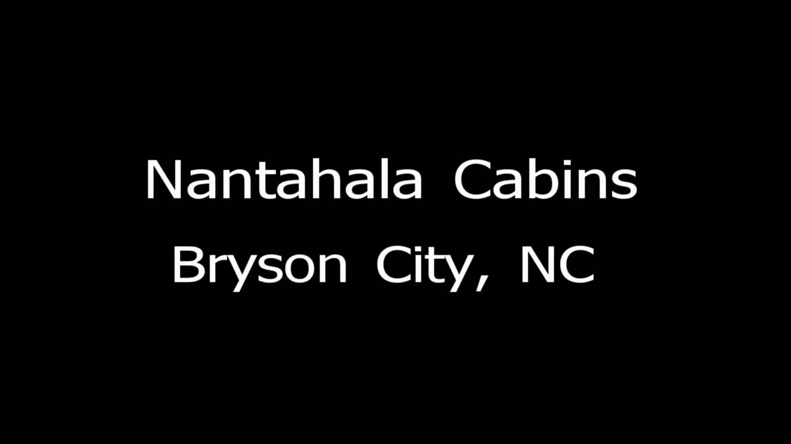
Nantahala Cabins
Please wait for interview to begin.

Slide 19
Check out our themed cabins.

Slide 20
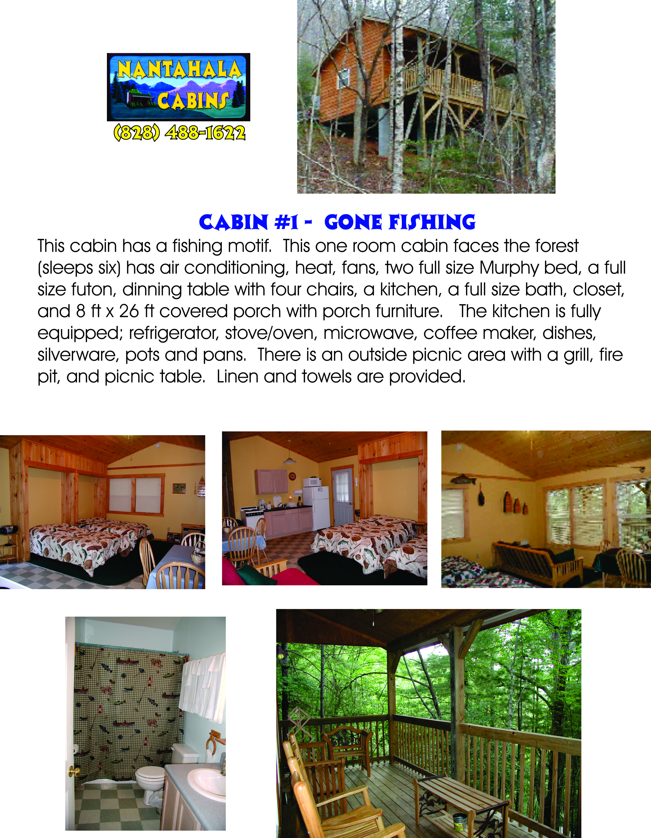

Slide 21
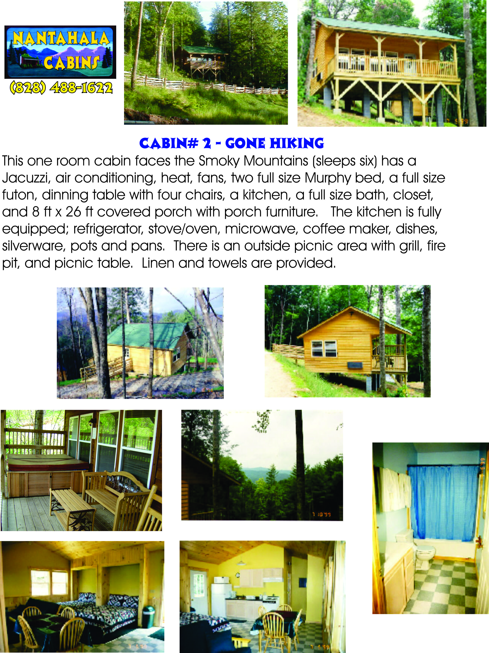

Slide 22
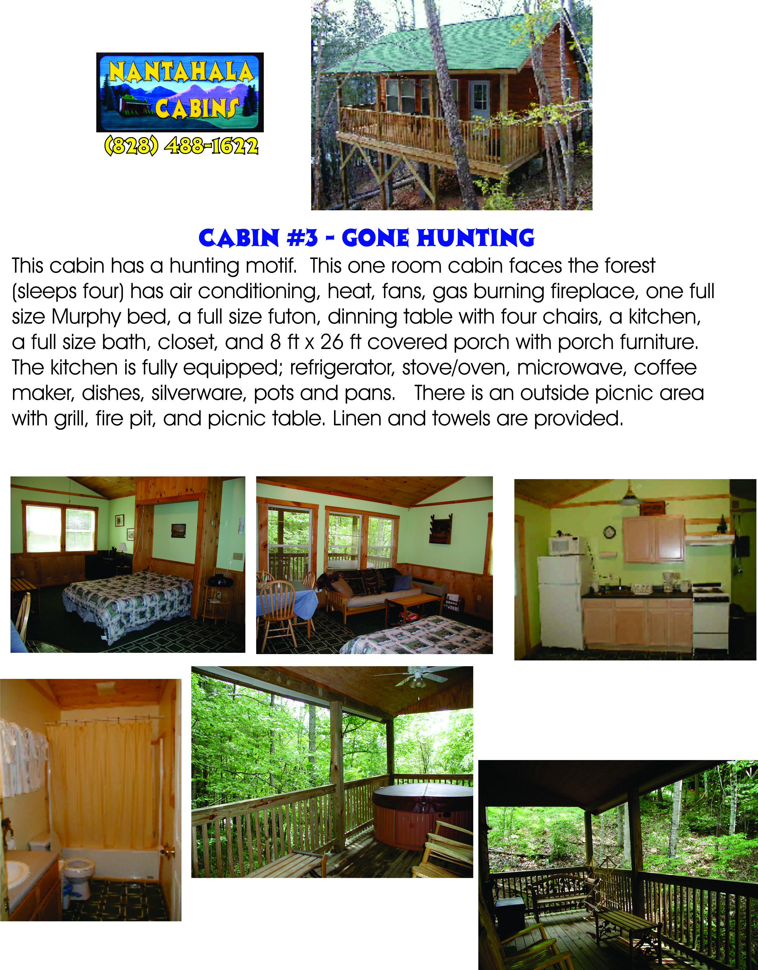

Slide 23
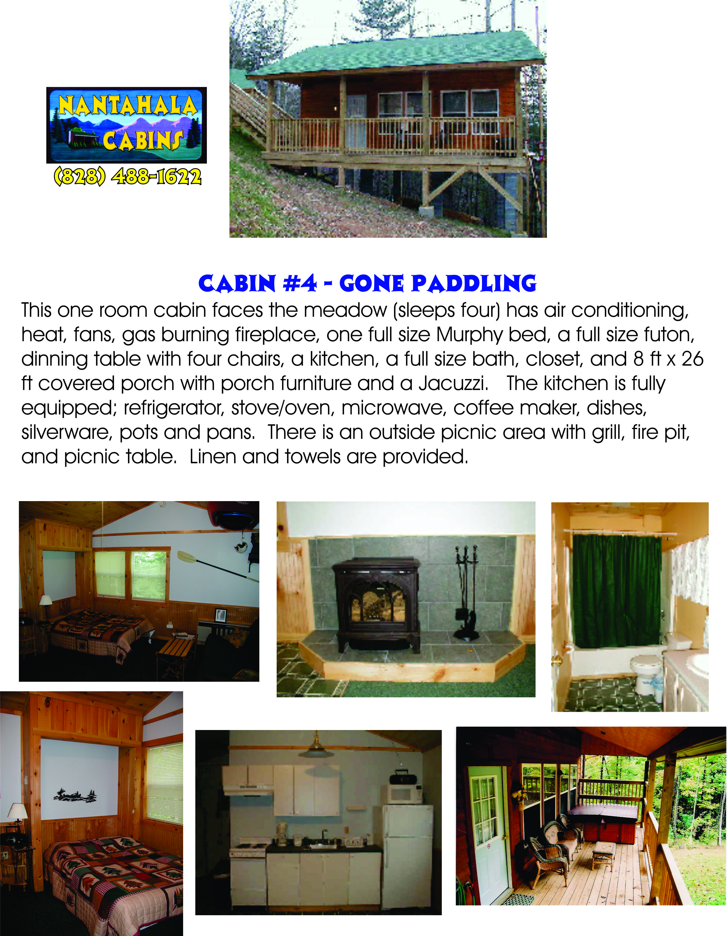

Slide 24
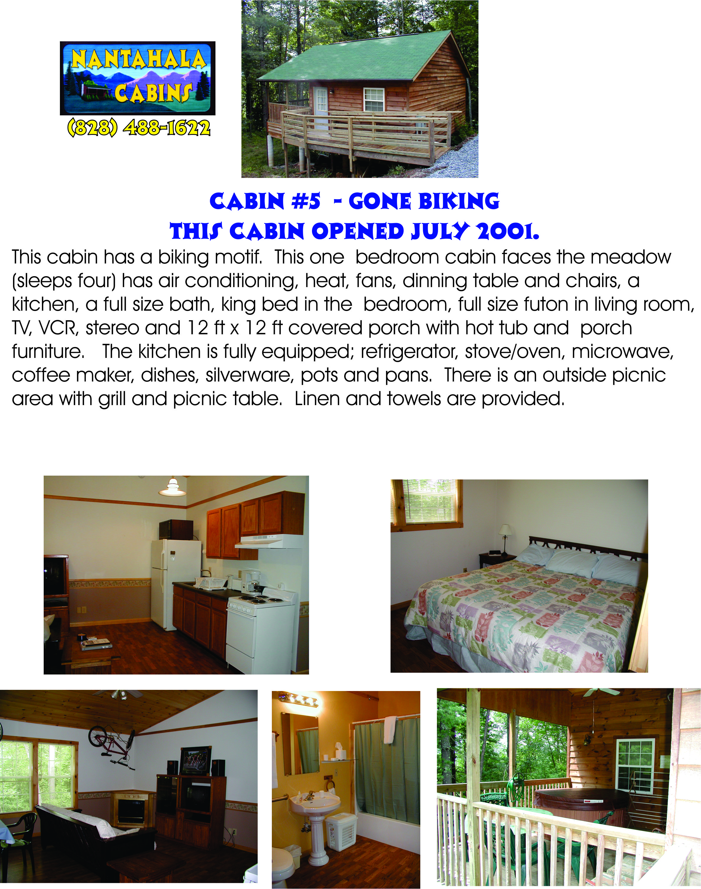

Slide 25
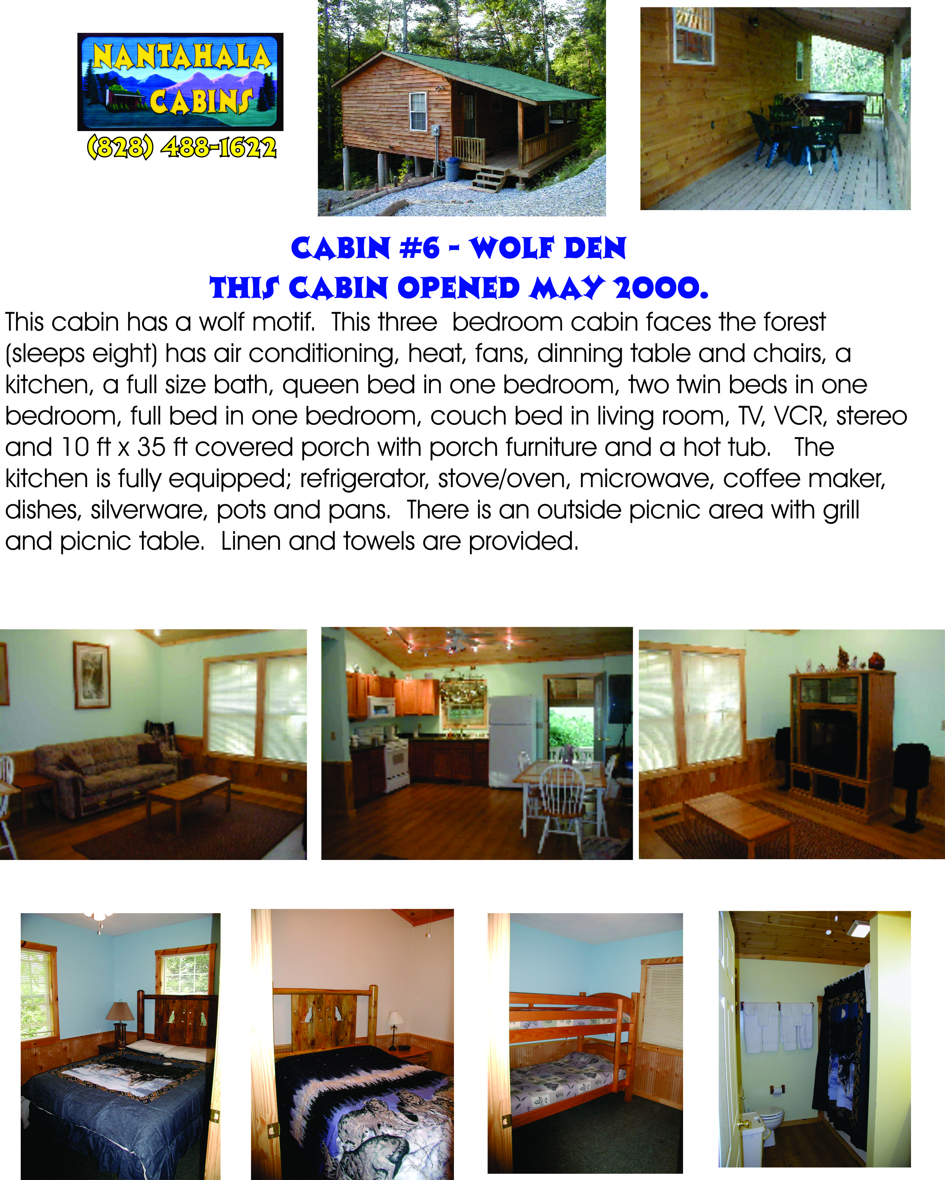

Slide 26
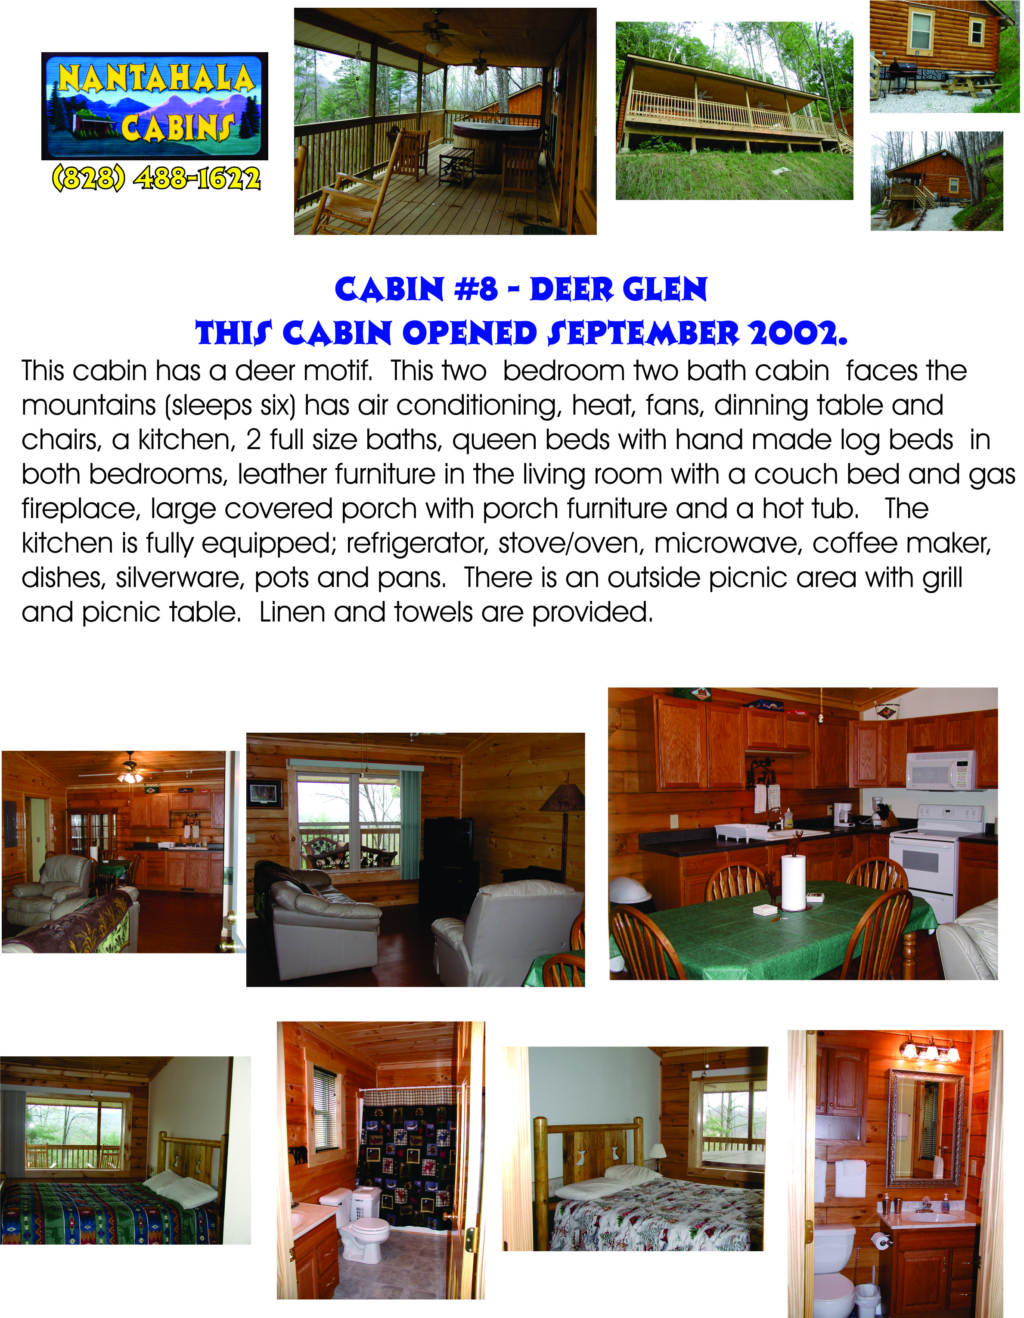

Slide 27
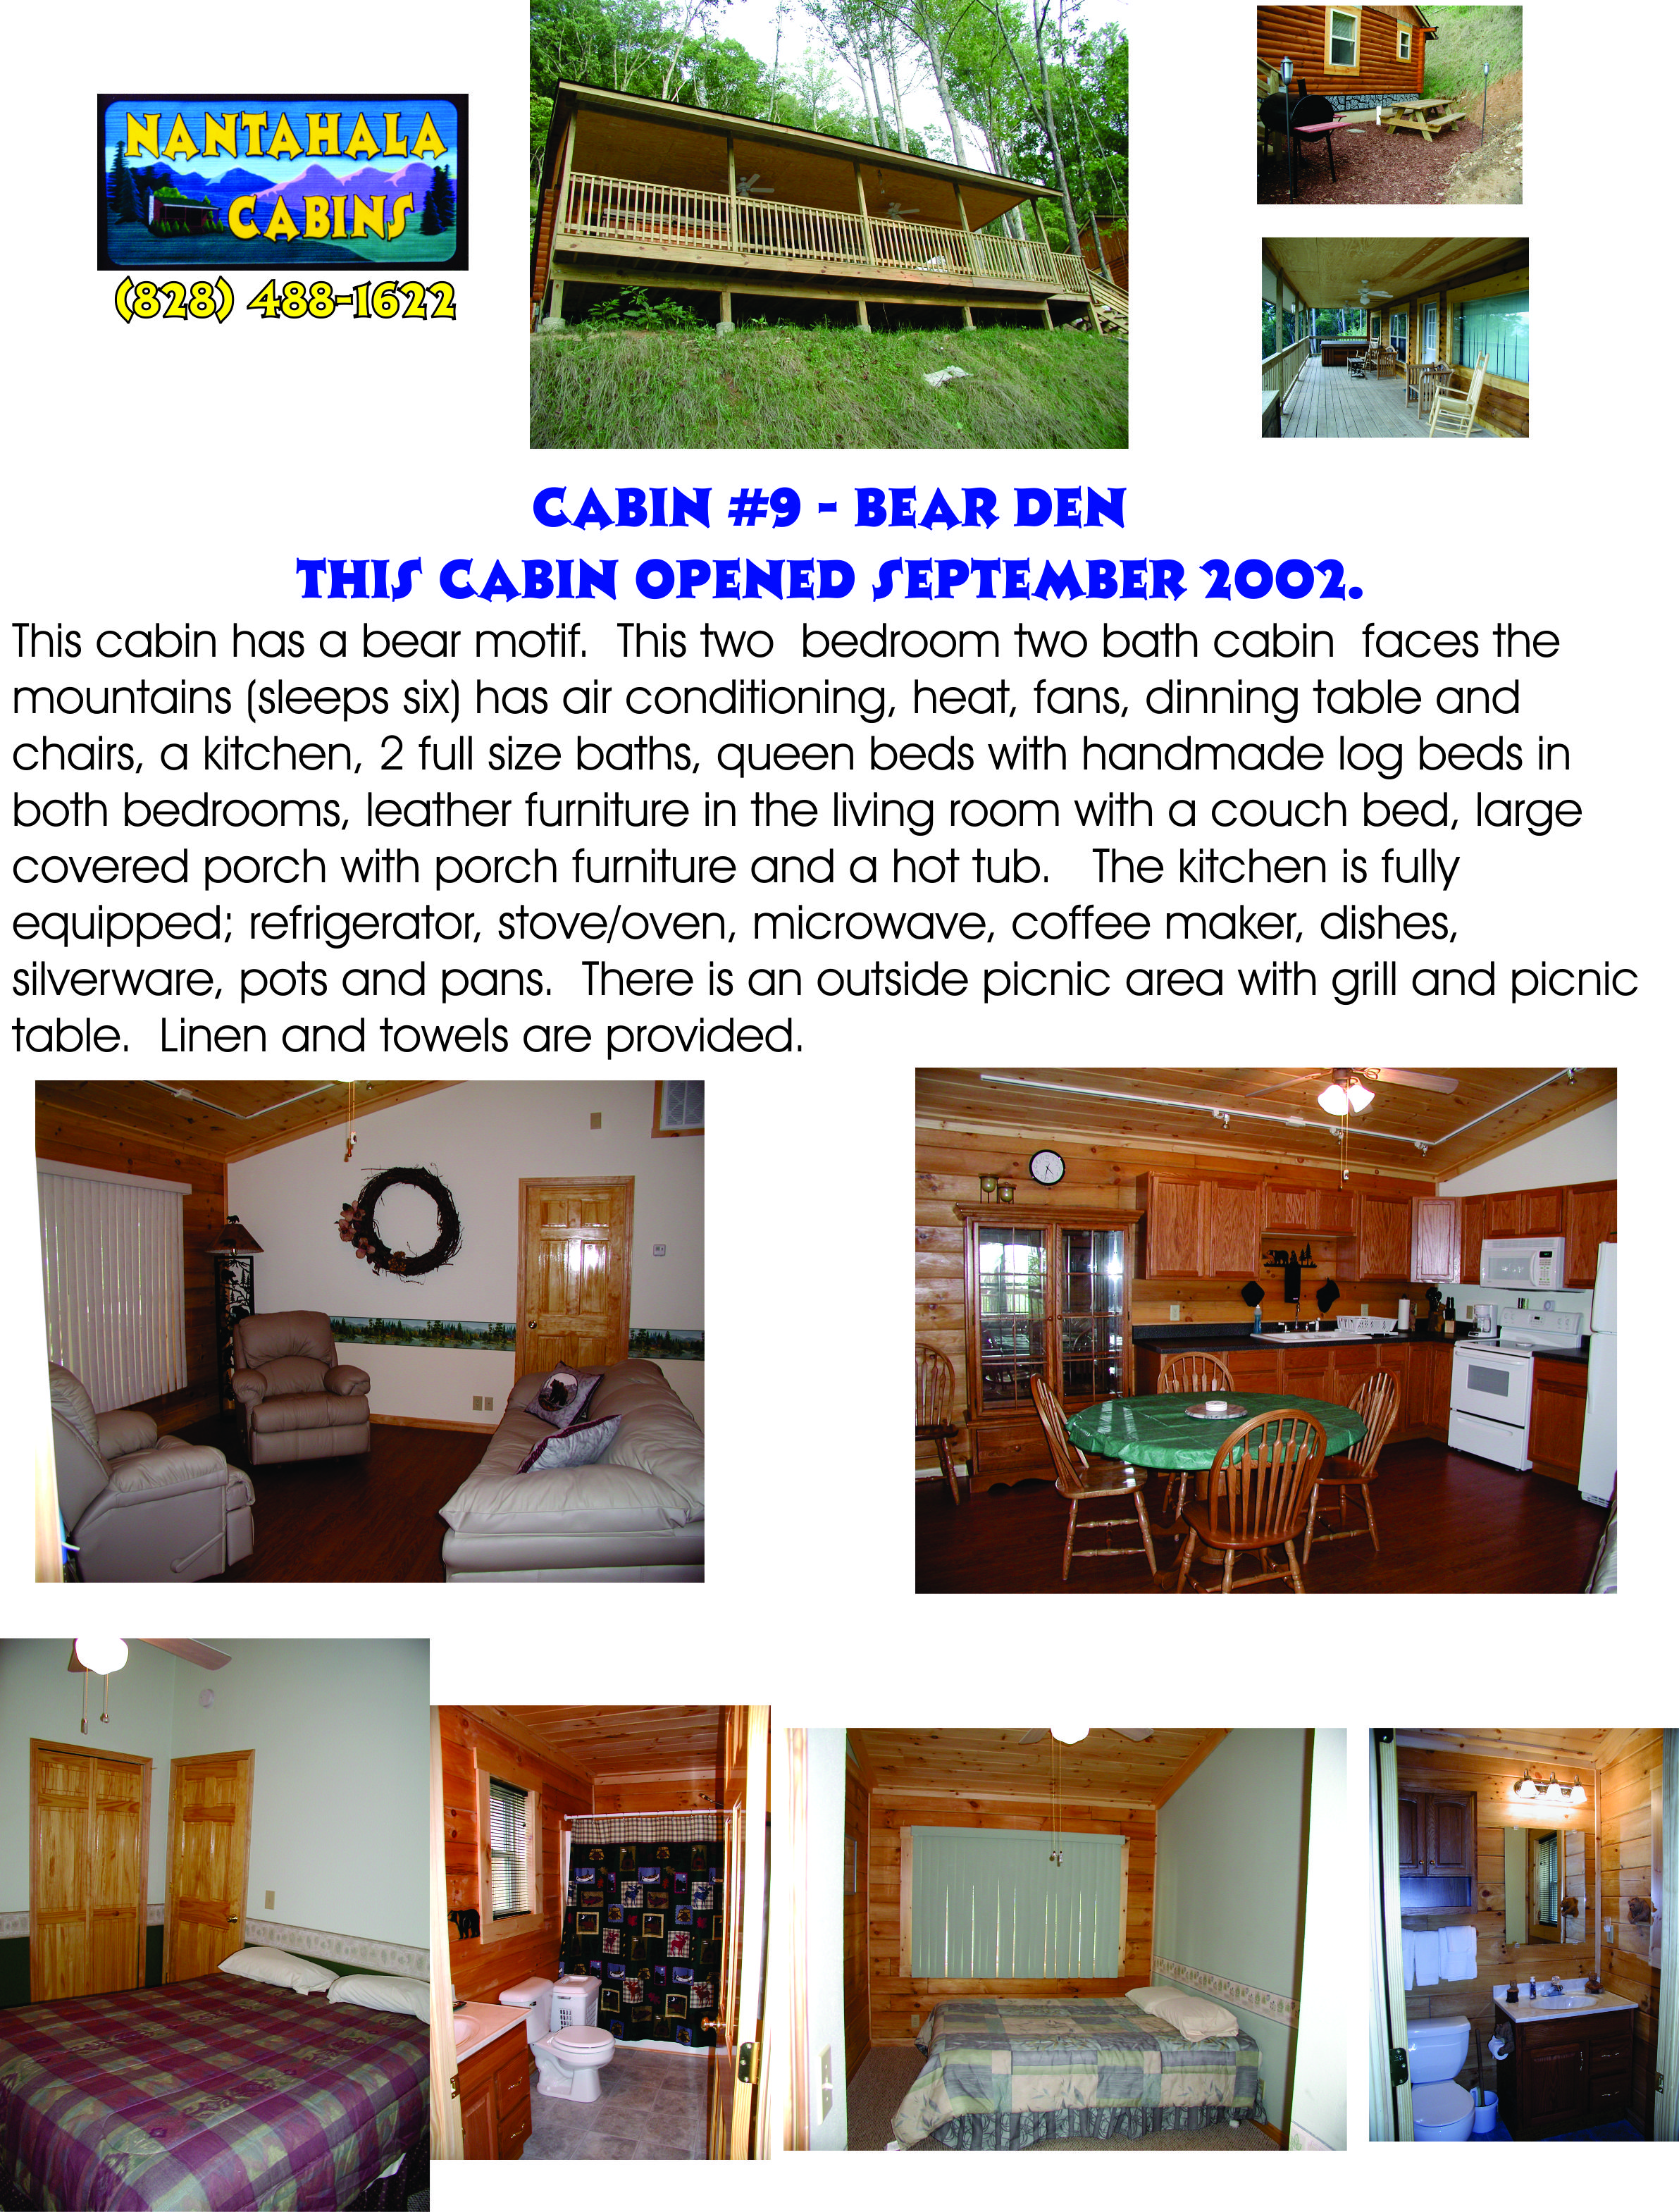

Slide 28
I have interviewed Entrepreneurs in Western North Carolina’s tourism industry and set up my final product to also help market these entrepreneurs.
It was interesting to see that some businesses thrived in this down economy and how some businesses were managing their struggles.
Please visit some of theses businesses in Western North Carolina to help further their endeavors.

Slide 29
Entrepreneurs of
Western North Carolina’s
Tourism Industry
Jeanette E. Marceau
Masters of Entrepreneurs
Western Carolina University
Cohort 8
December 2010

